Slide 1
Business Analysis Row Houses Development
Created by
Dipali Mendhe

Slide 2
CONTENT
Introduction
Our Project
Project Vision
Design and Architecture
Amenities and Features
Sprint Planning
Project Framework
Roles and Responsibilities
Sprint Dashboard
Estimated Budget
Conclusion

Slide 3
Introduction
What is Row House?
Demand of Row Houses

Slide 4
Our Project
Project Name: Row House Development Project
Location: Besa, Nagpur
Project Type: Residential Row Houses
Target Market: Middle-class families, first-time homebuyers, investors
Project Duration: 03 March 2025 – 03 November 2025

Slide 5
Project Vision
Our vision is to create a successful community which promotes a high quality of life to its residents.
We are committed to incorporating sustainable and innovative design to create homes that are not only beautiful but also environment friendly.

Slide 6
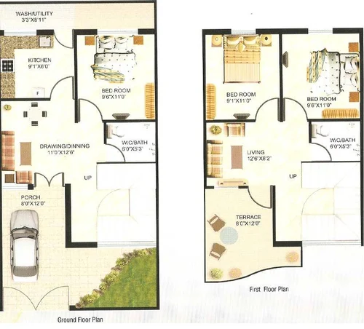
Design and Architecture
Spacious layouts with 2-4 bedrooms
Modern kitchen and bathroom designs
Solar panels for energy efficiency
Private outdoor spaces such as gardens or terraces
High-quality construction materials and finishing

Slide 7
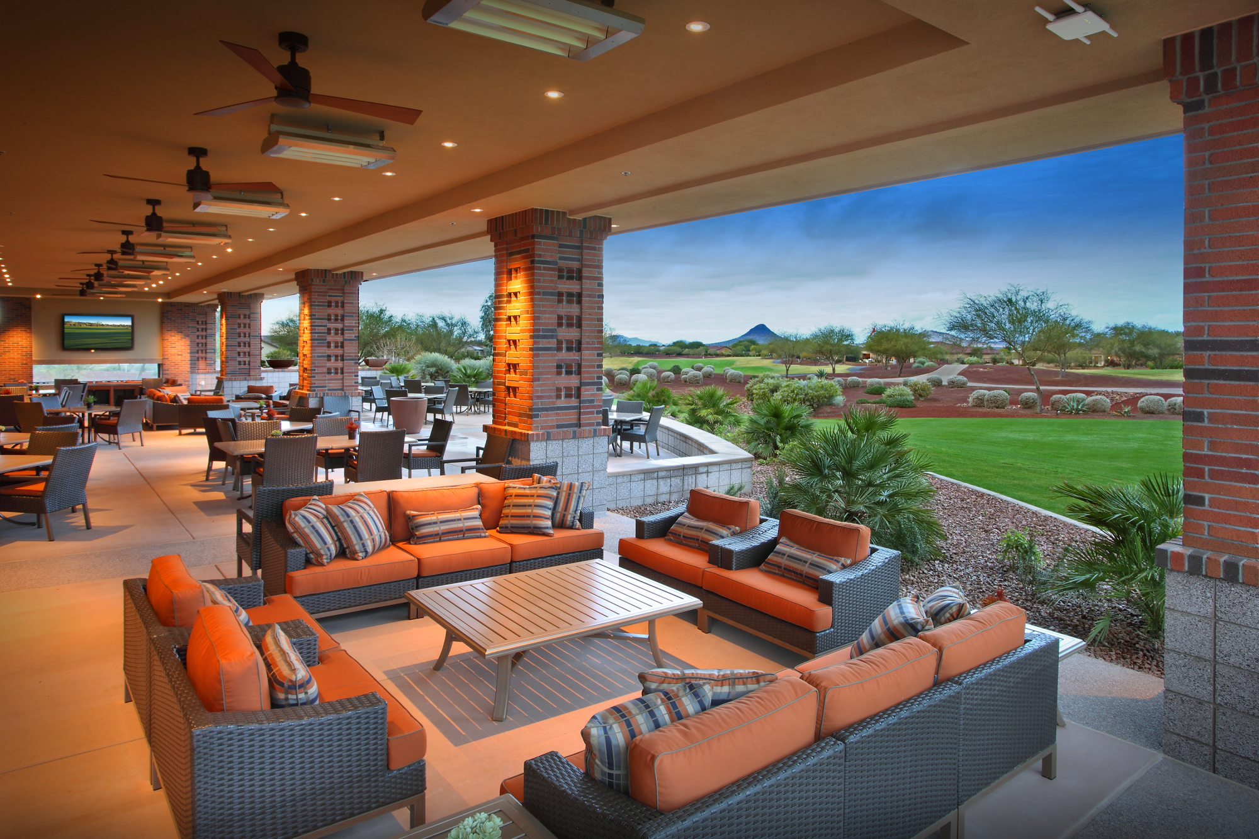
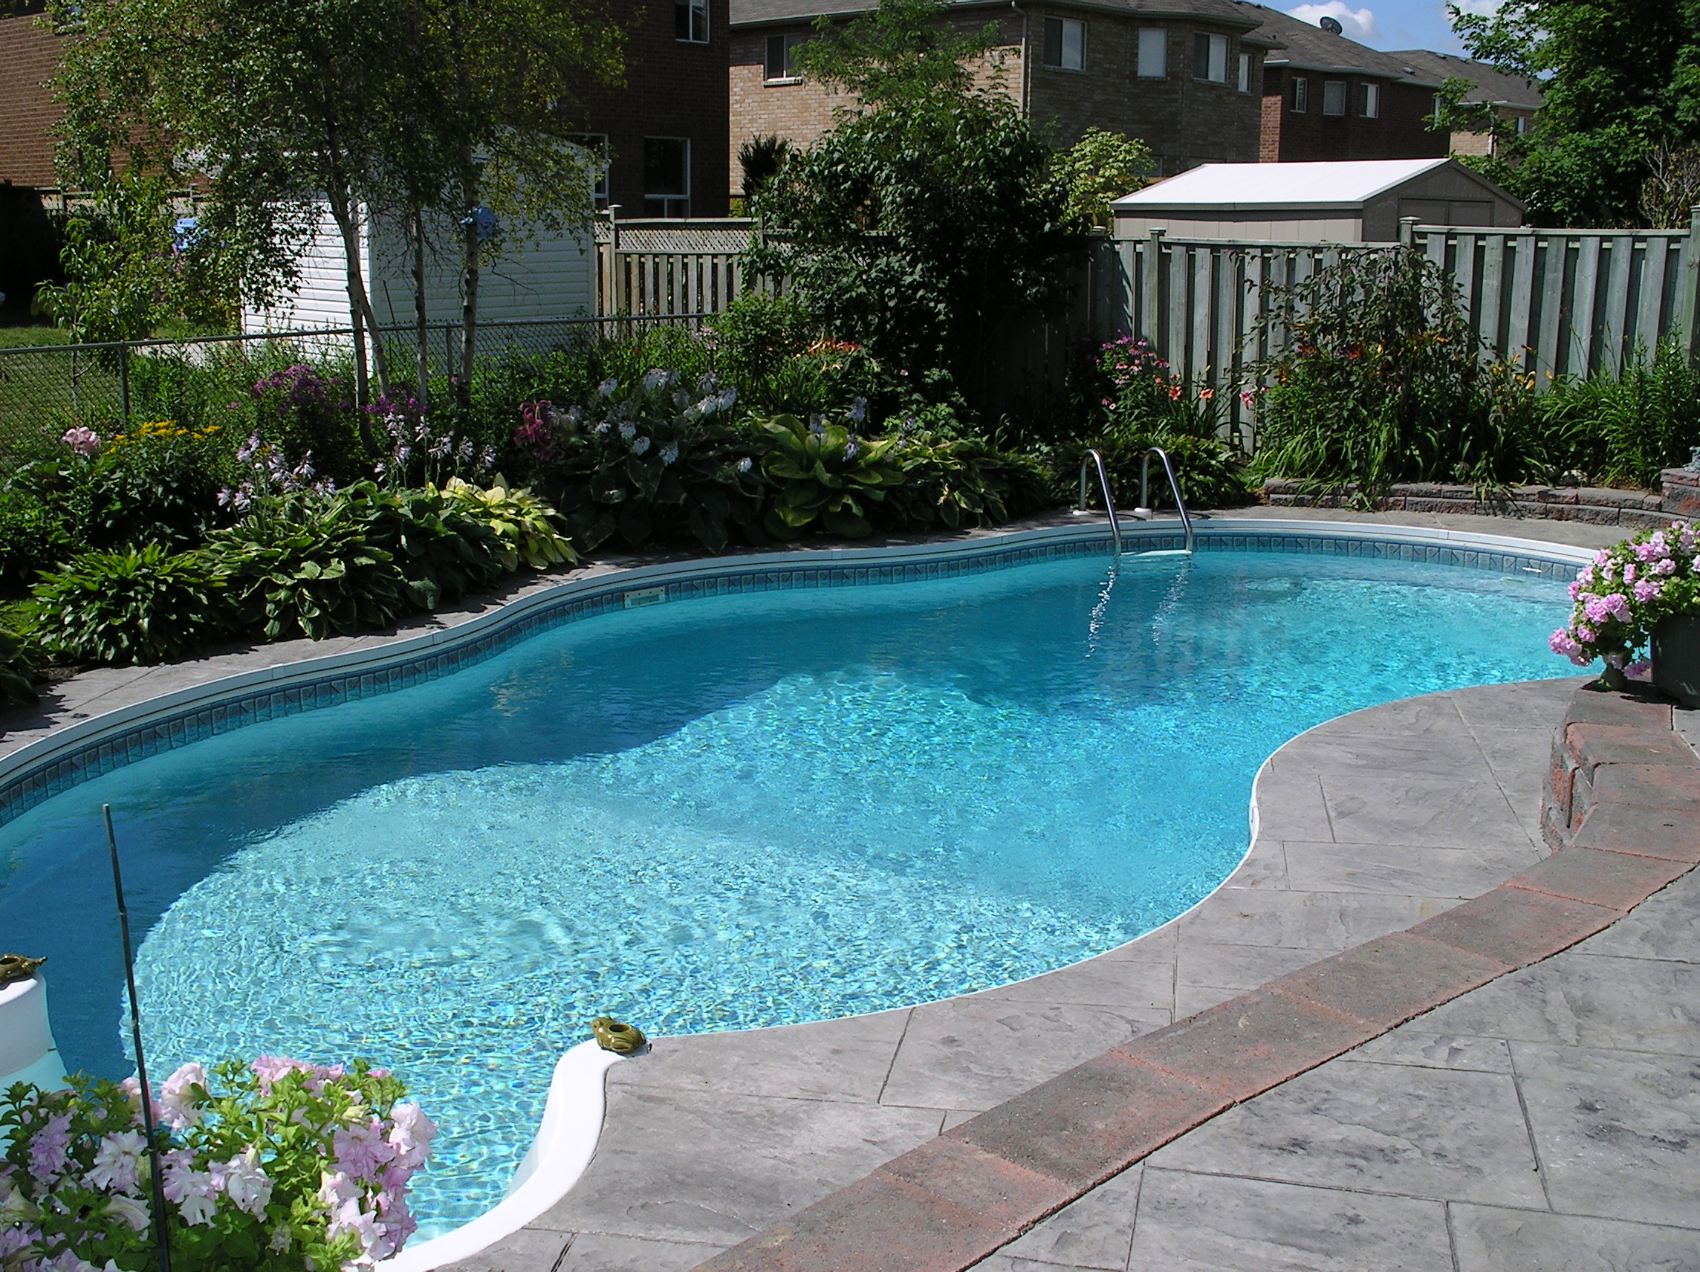
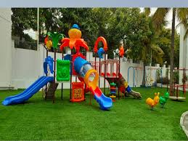

Amenities and Features
Community clubhouse and parks
Swimming pool and gym area
Children's play areas and sports courts
24/7 security and surveillance

Slide 8
Sprint Planning
Phase 1
Planning and Design
Phase 2
Infrastructure Development
Phase 3
Construction of Row Houses
Phase 4
Finishing and Interiors
Phase 5
Final Inspection and Handover

Slide 9
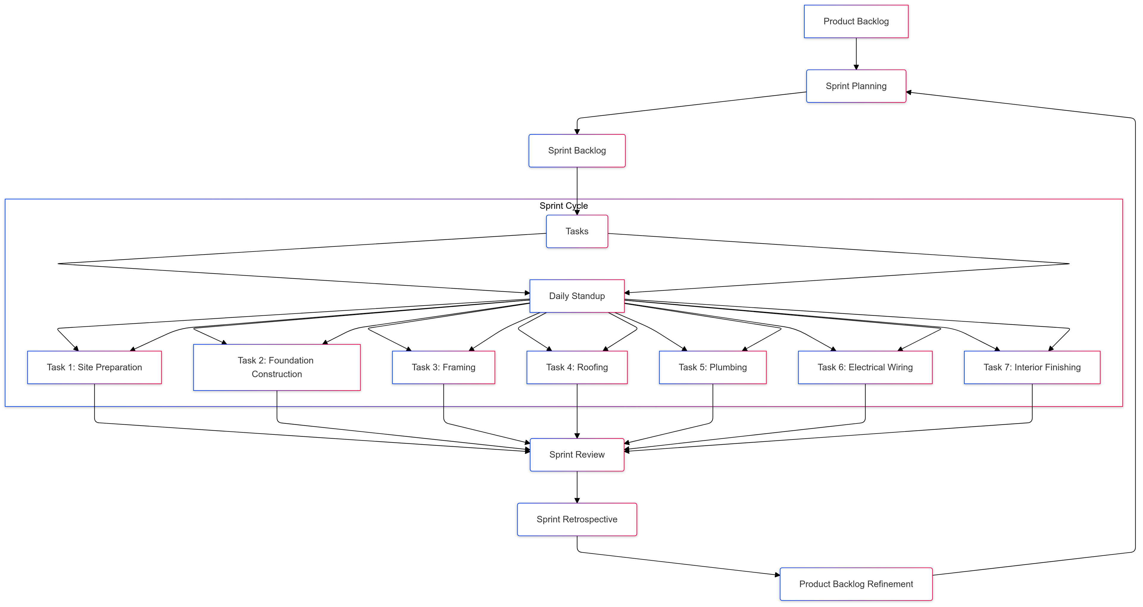
Project Framework

Slide 10
Roles and Responsibilities
Project Manager: Defines project vision, prioritizes tasks, and communicates with stakeholders.
Scrum Master: Facilitates Agile processes and removes obstacles.
Construction Team: Includes architects, civil engineers, interior designer, contractor, and surveyor and exterior designer.
Finishing Team: Includes landscaper, electrician, plumber and painter.

Slide 11
Sprint Dashboard

Slide 12
Estimated Budget

Slide 13
Conclusion
In constructing row houses involves different stages from planning and design to final handover. Each stage, including pre-construction, groundwork, foundation, exterior, interior works, and finishing, contributes to ensuring the durability, functionality, and quality of the final structure.
Throughout the construction process, quality, standards and regulations is crucial to delivering safe and comfortable living spaces. The involvement of skilled professionals, from architects and engineers to contractors and inspectors, guarantees that each aspect of the construction is executed with precision and expertise.

Slide 14
Thank You

